Slide 1


MUMS Manufacturing Unit Monitoring System
Module 6: Advance Java Project
-by
Devi Dinesh (36)
Hrushikesh Shashikant More (46)
Mayur Ashok Shinde (57)

Slide 2

Motivation Behind MUMS
Small Scale Industries (SSI) are those industries in which the manufacturing, production and rendering of services are done on a small or micro scale, with the help of small machines and less manpower.
Managing the production, employee-customer details, tracking daily activity and income-expenditure calculations becomes the major concern of such organisations.
MUMS provide an online service where-in it becomes a one stop solution for all the above problems.
5-in-1 Role Played by MUMS
Employee management system
Salary management system
Customer management system
Order and production management system
Activity tracker

Slide 3
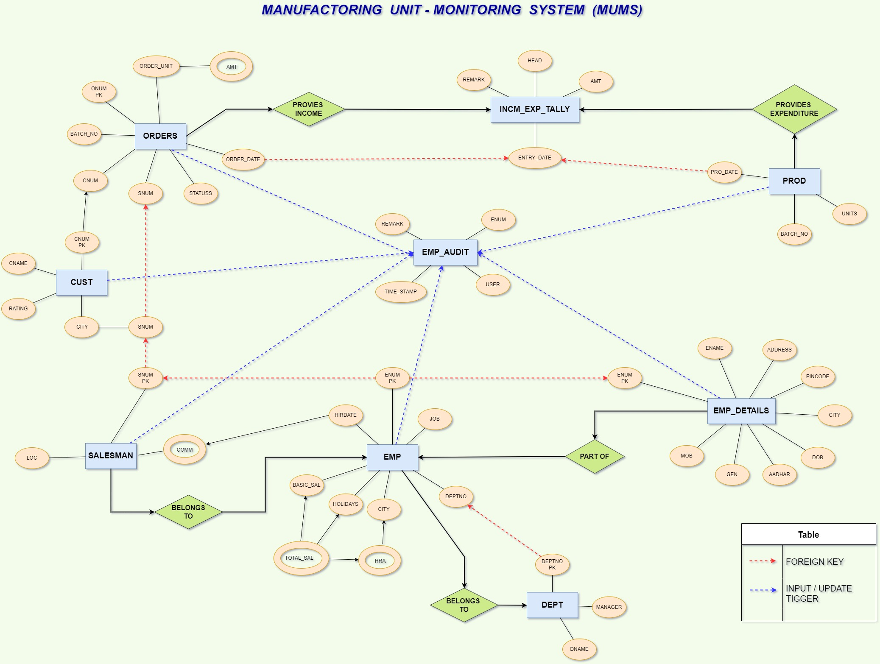
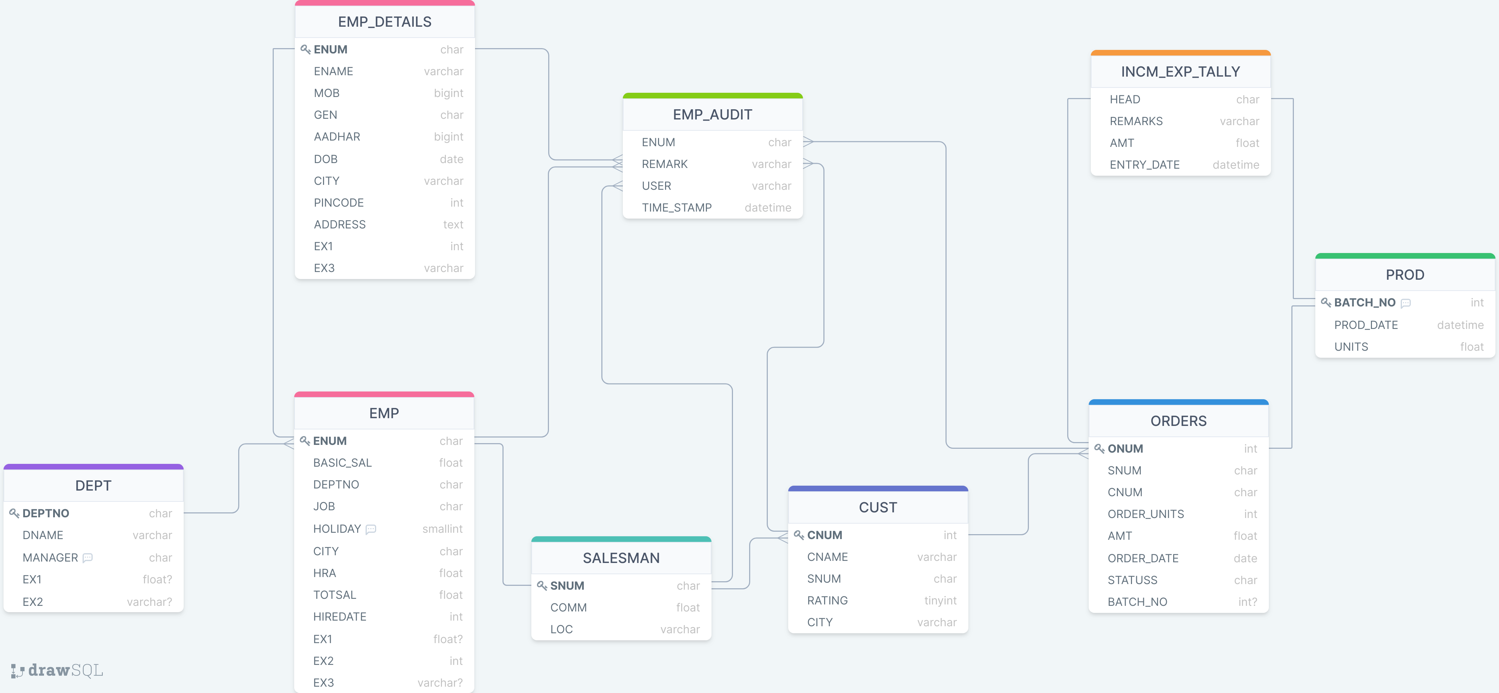
MUMS – Back End

Slide 4
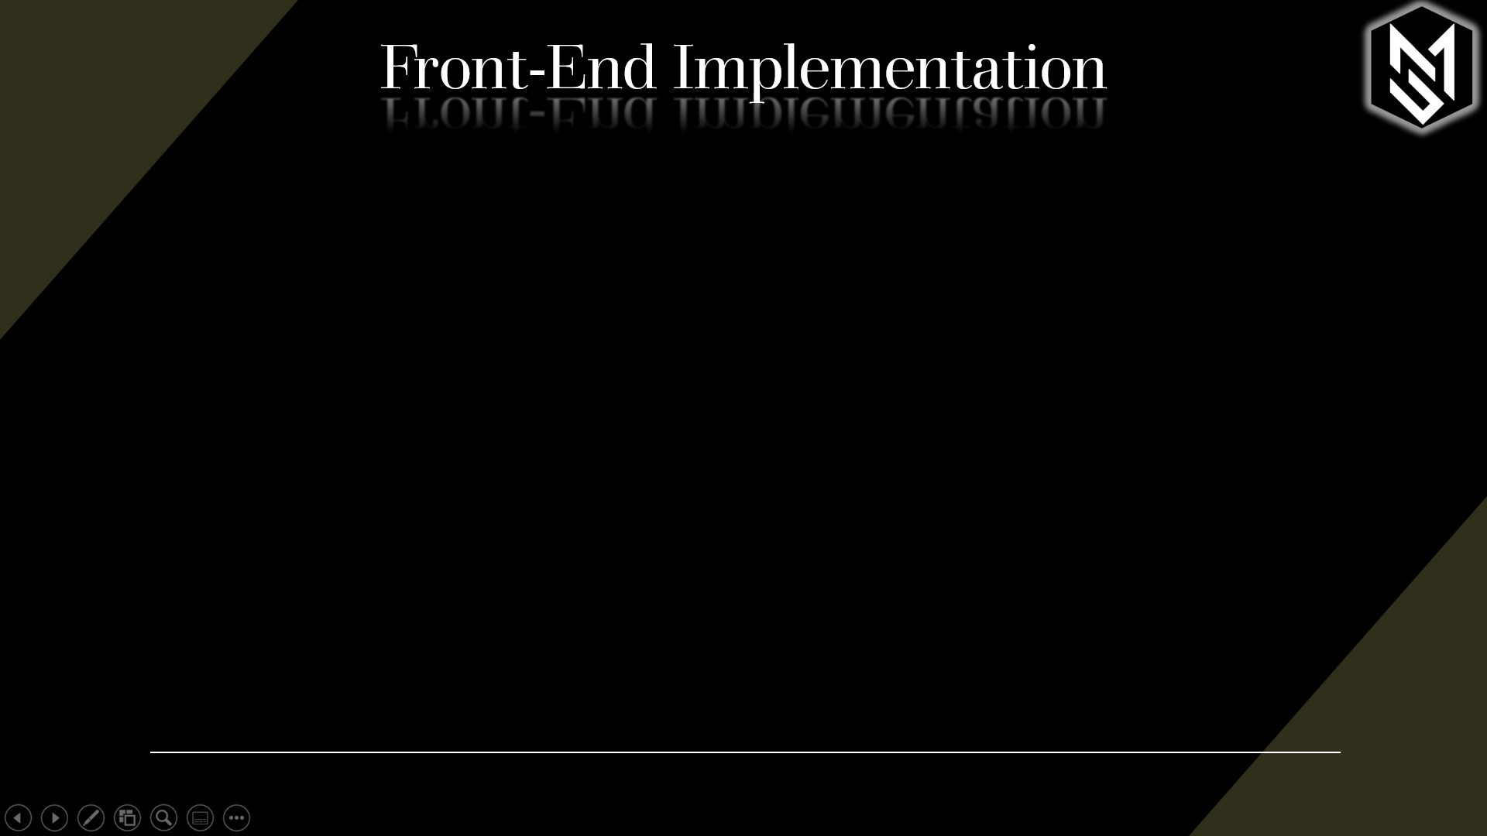
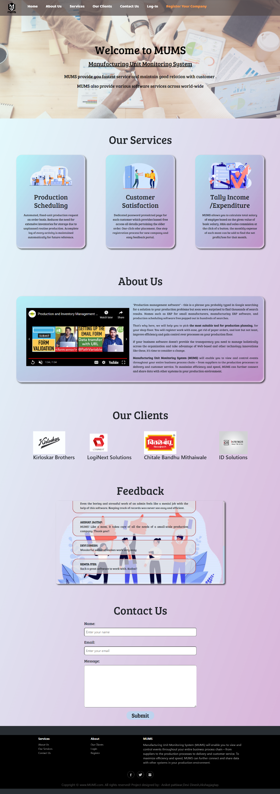
Front-End Implementation

Slide 5
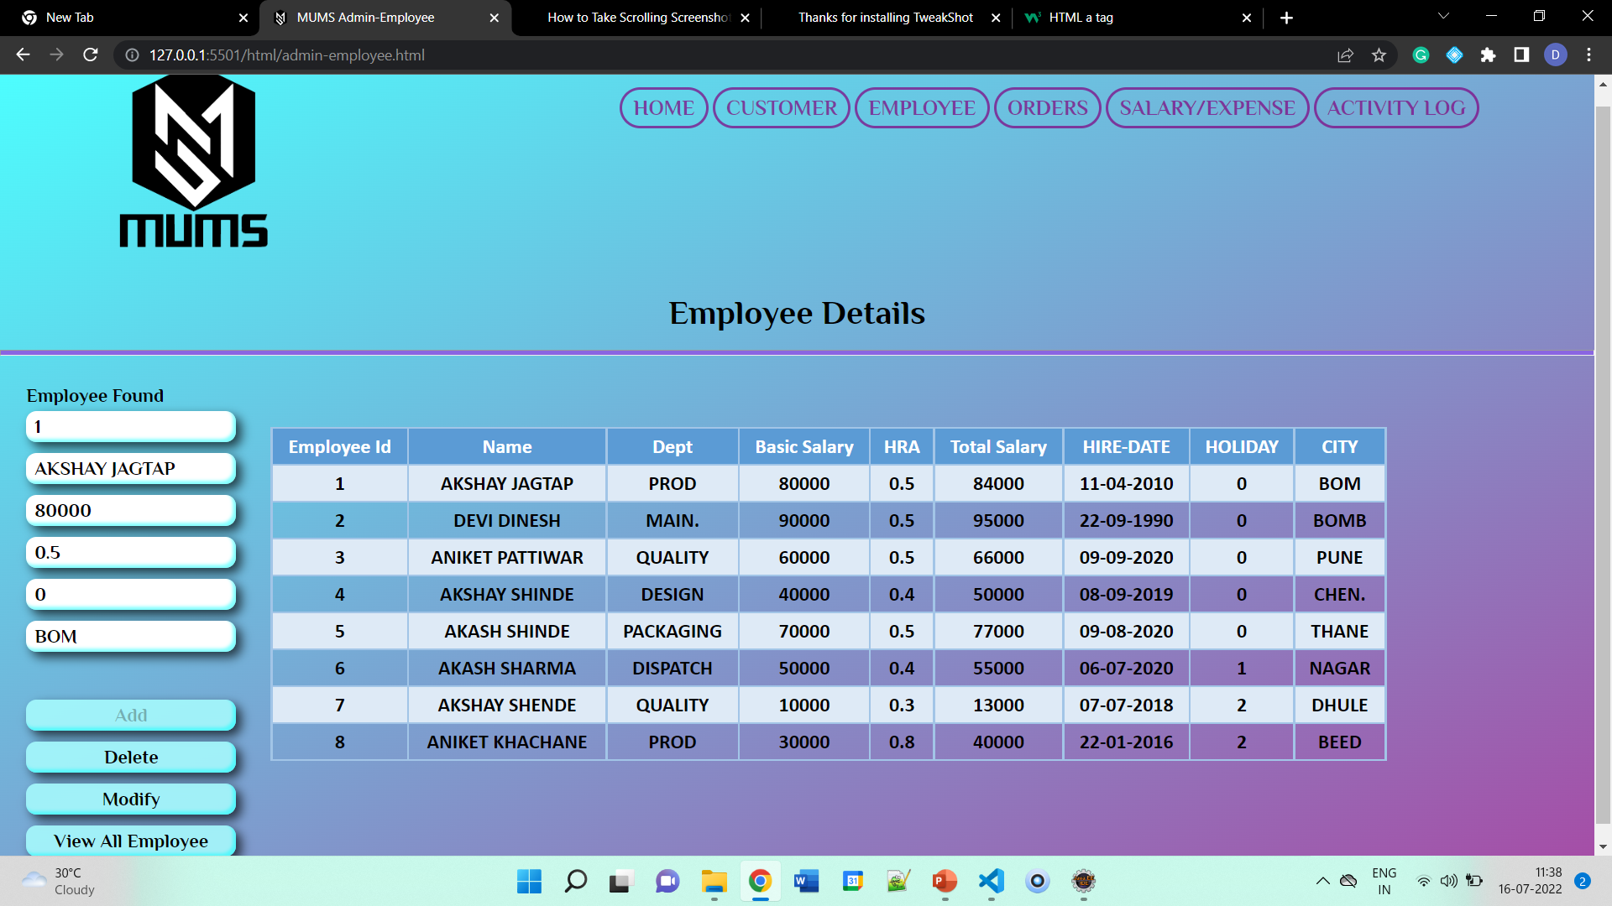
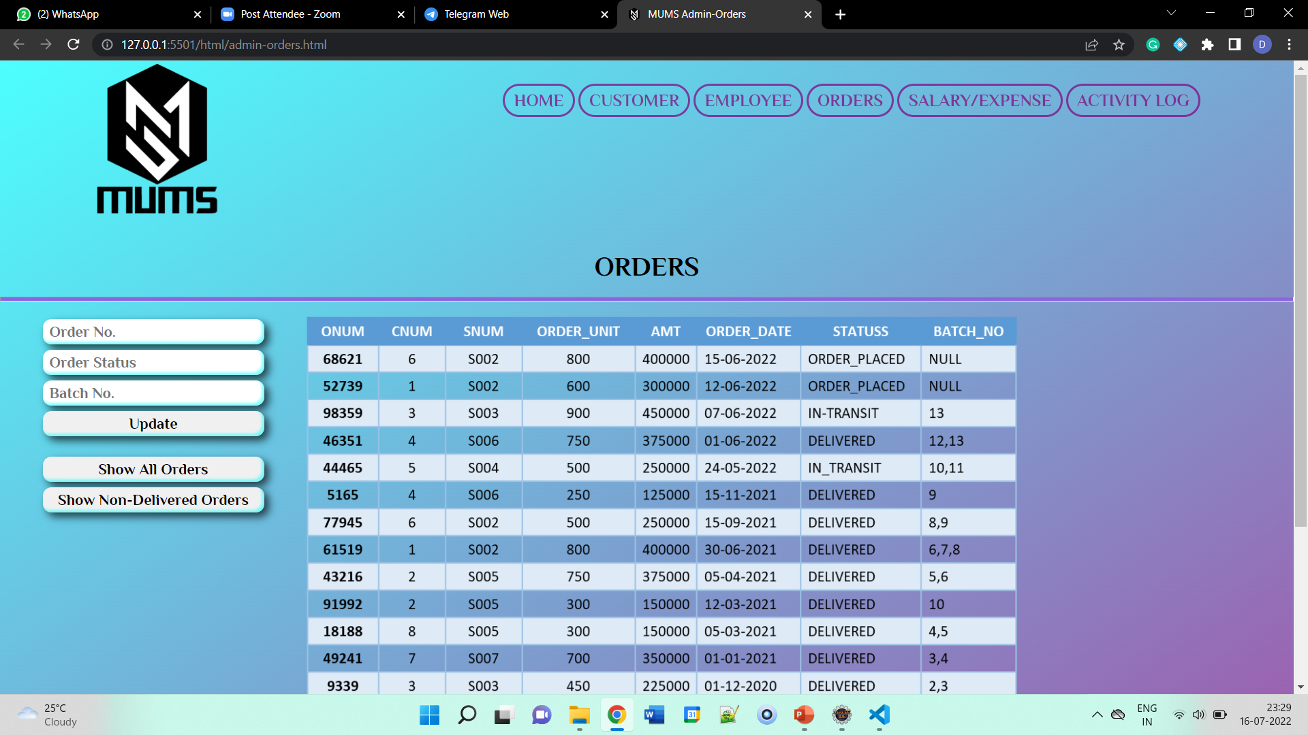
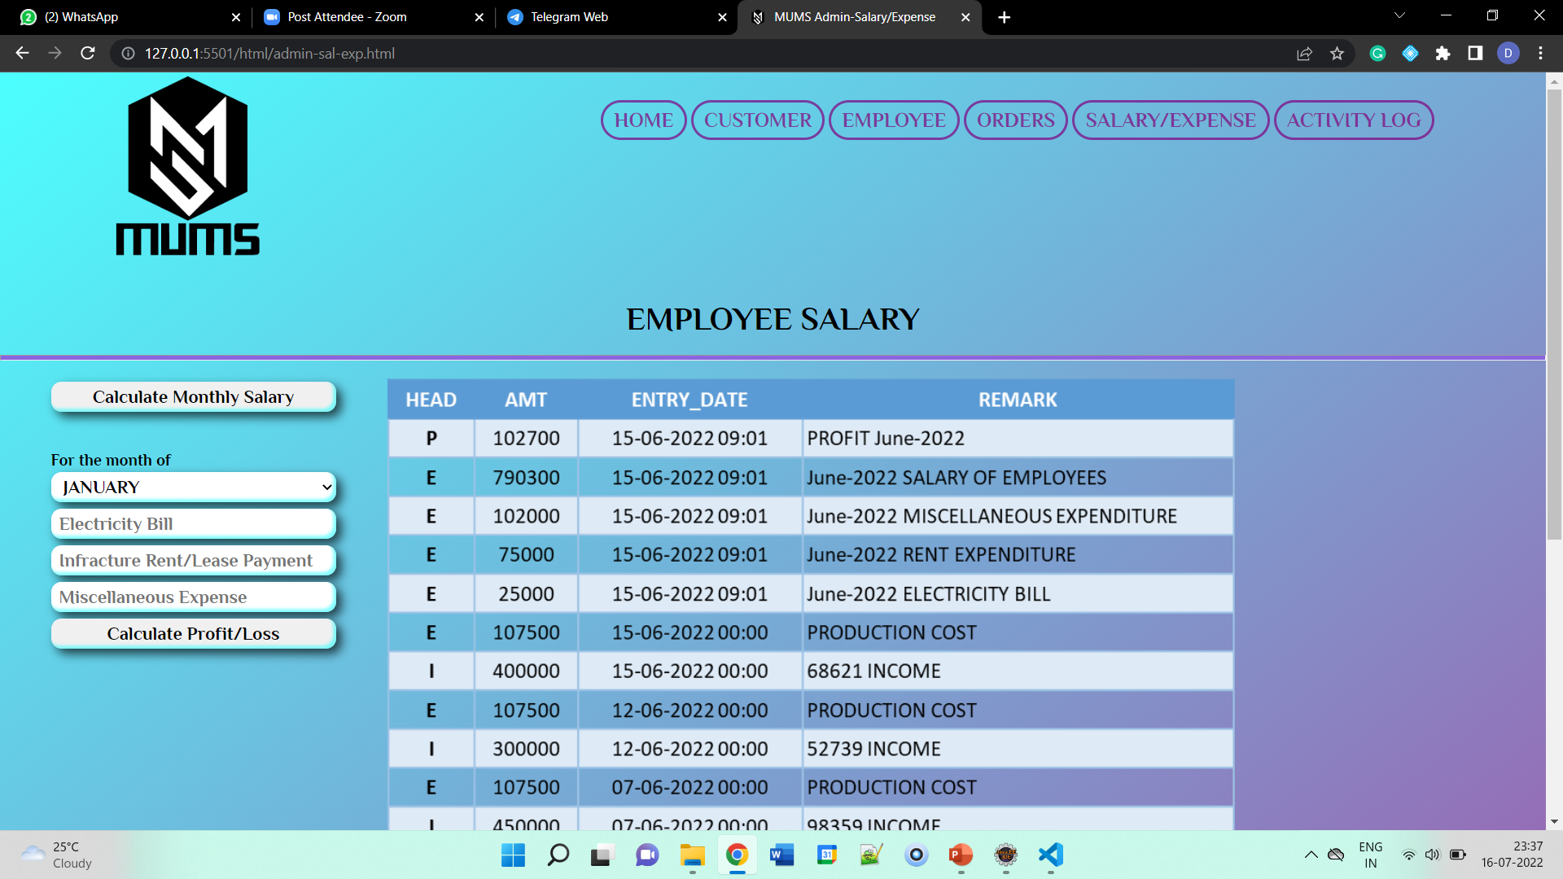
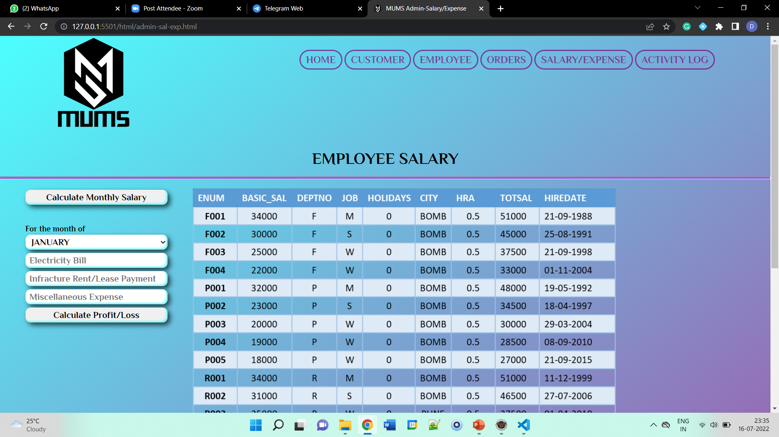
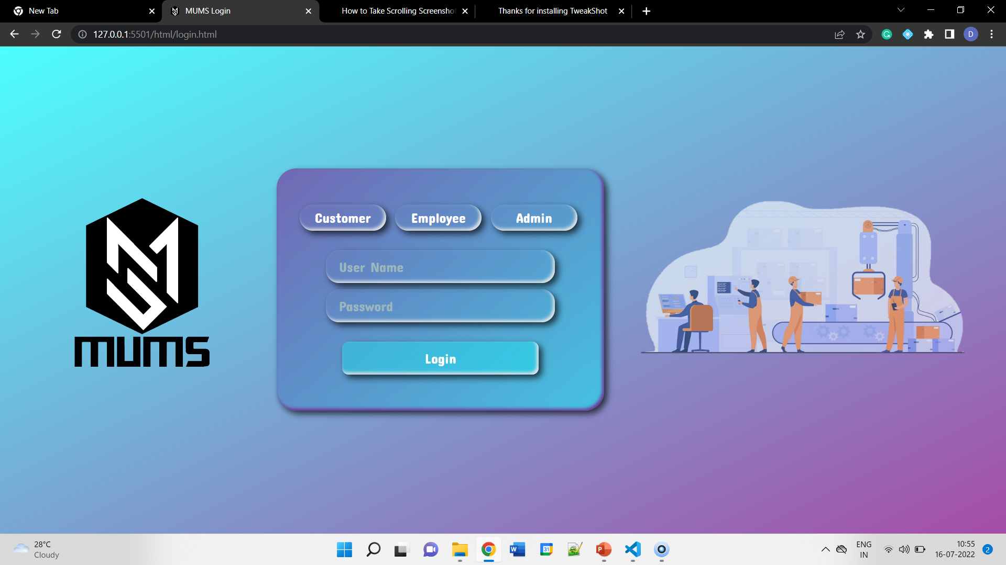
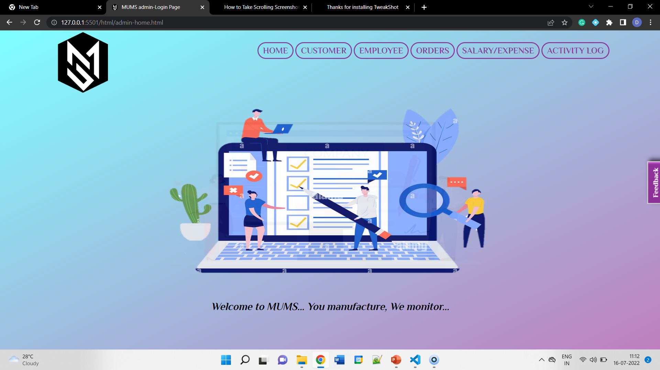
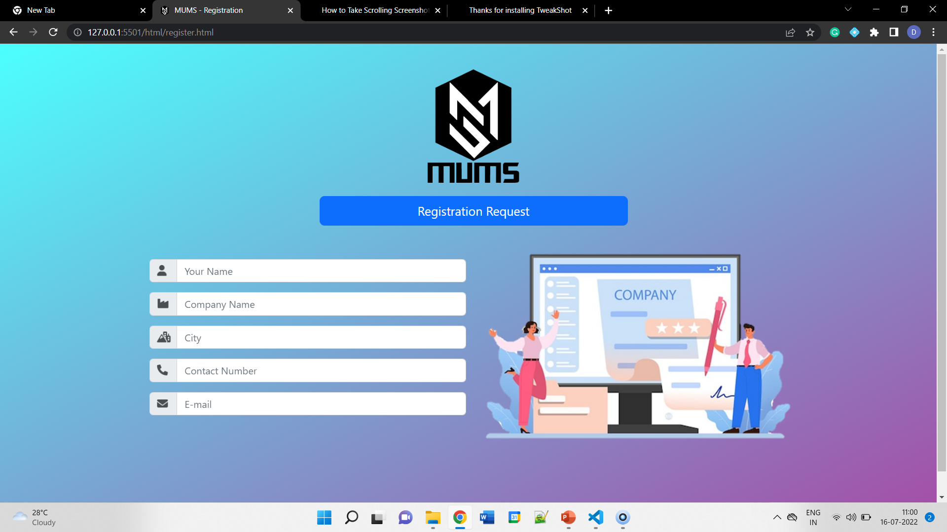
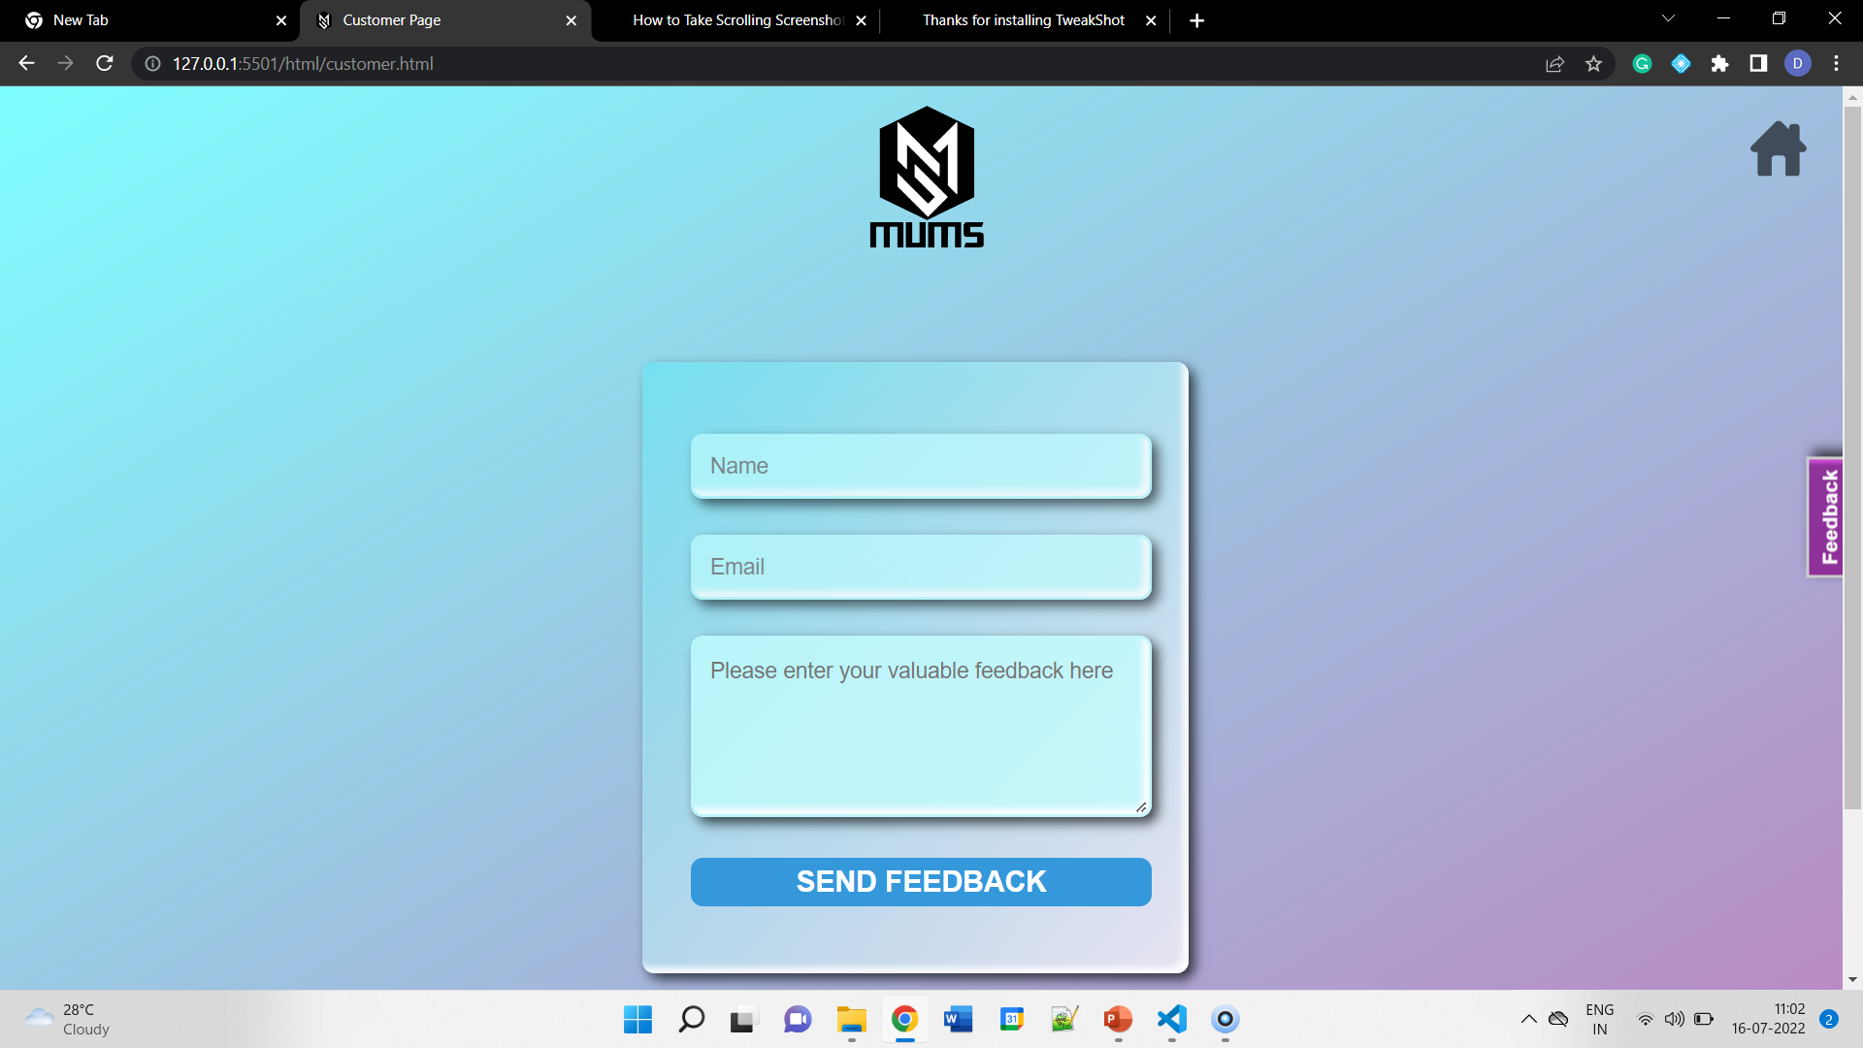
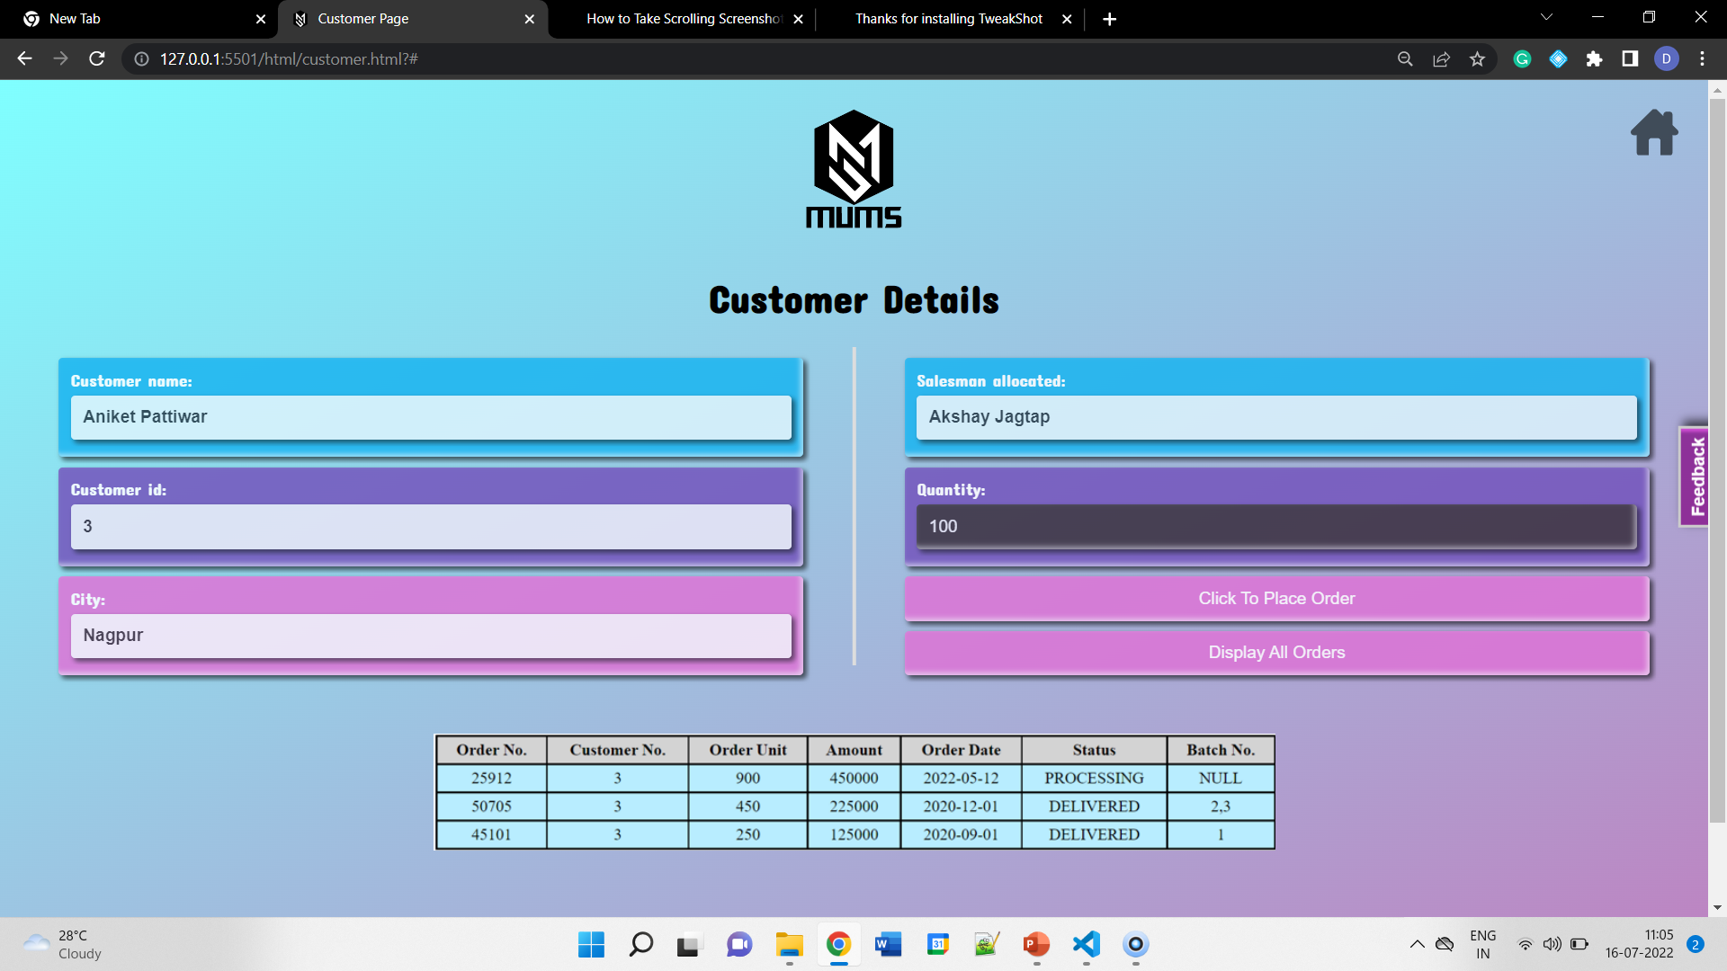
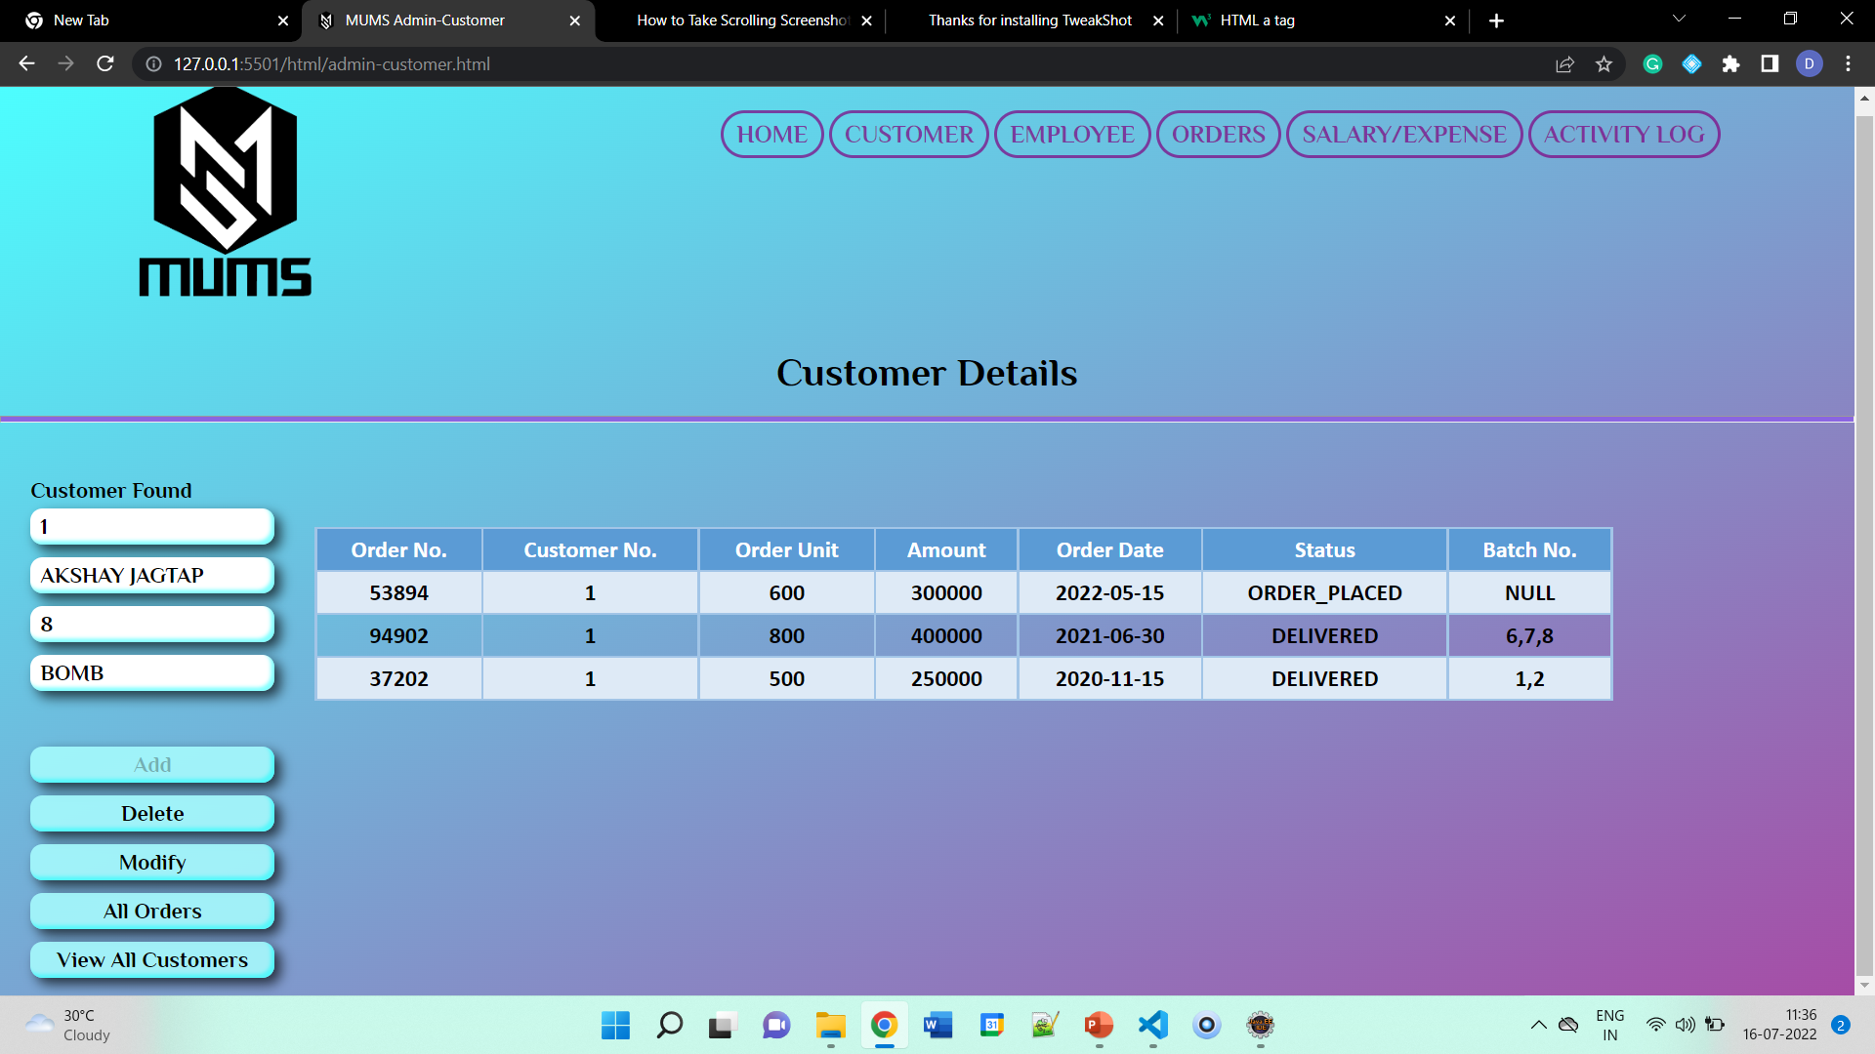
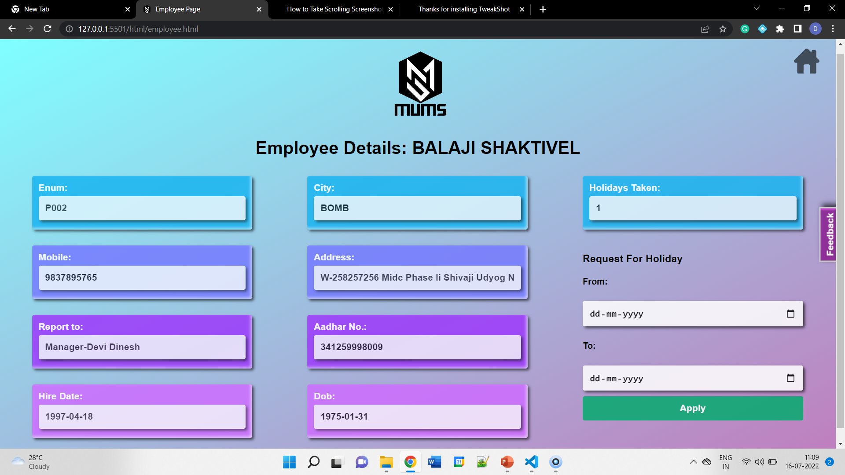
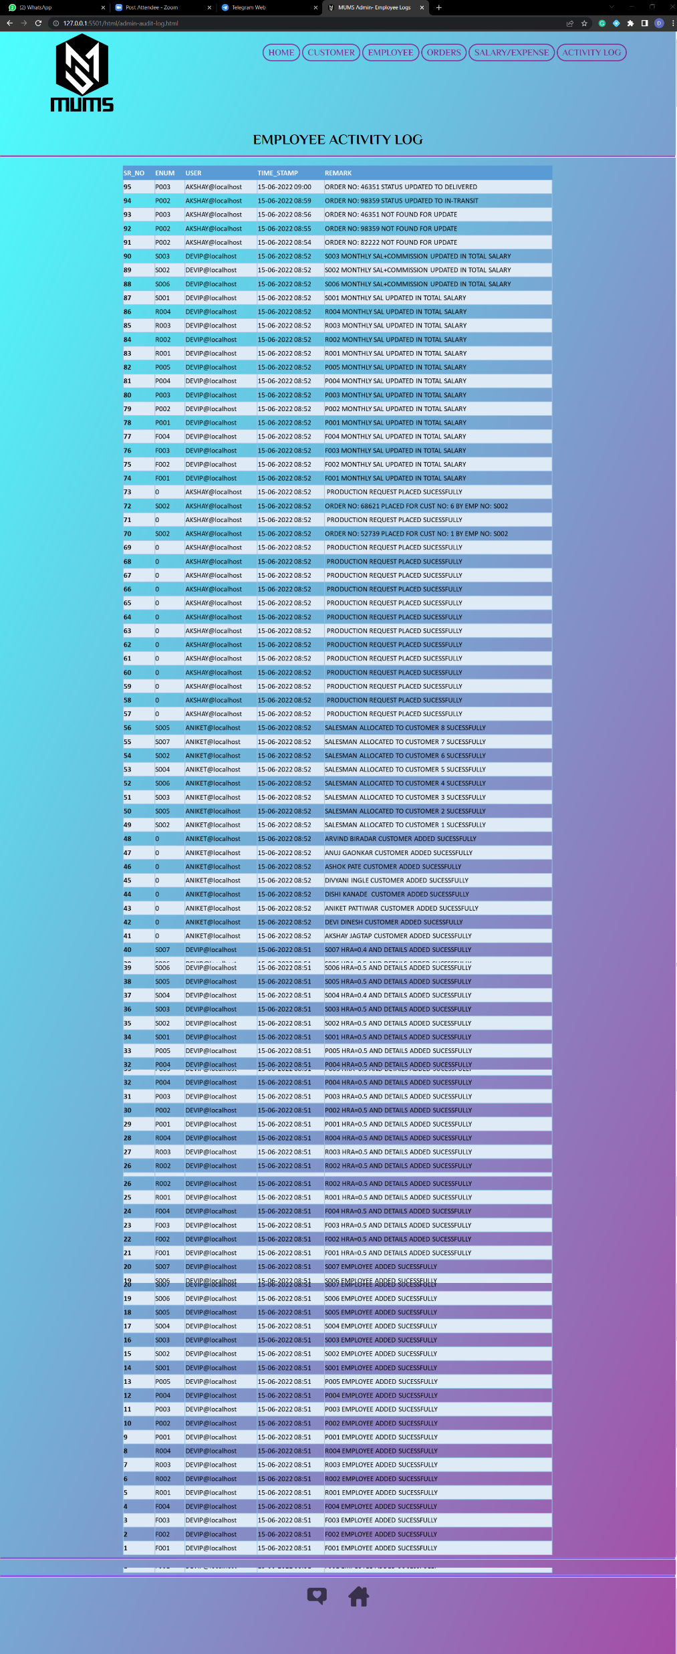
Front-End Implementation
Admin Login Page
Admin Login Page - Employee
Admin Login Page - Orders
Admin Login Page – Profit / Loss Calculation
Customer Login Page
Registration Page
Employee Login Page
Login Page
Admin Login Page – Salary Calculation
Dynamic Feedback Button (After Login)
Admin Login Page - Customer

Slide 6

MUMS-Advance Java
Registration and Form validation (Bean Validation)
Role based Login
CRUD Operations on Data-Base
Adding new User (Admin, Customer, Employee)
Customer can place new order
Customer can see previous orders
Customer can update their password
Admin can see all users and orders
Admin can delete any user
Customer if deleted, deletes the record of his orders

Slide 7
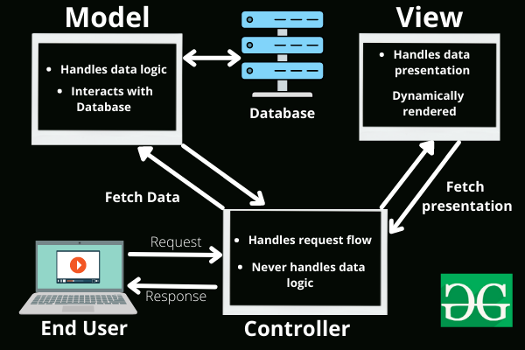
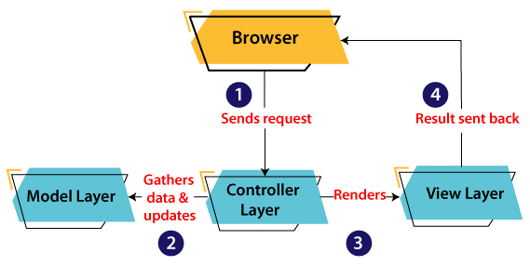


Concepts And Technologies Used
MVC Architecture
Servlet & JSP
Hibernate
MySQL

Slide 8


